Slide 1

L18 Server-side Development: PHP
Ch 12

Slide 2
In this chapter you will learn . . .
What is server-side development
PHP language fundamentals
PHP arrays, objects, and functions
Using PHP superglobal arrays to access HTTP content

Slide 3
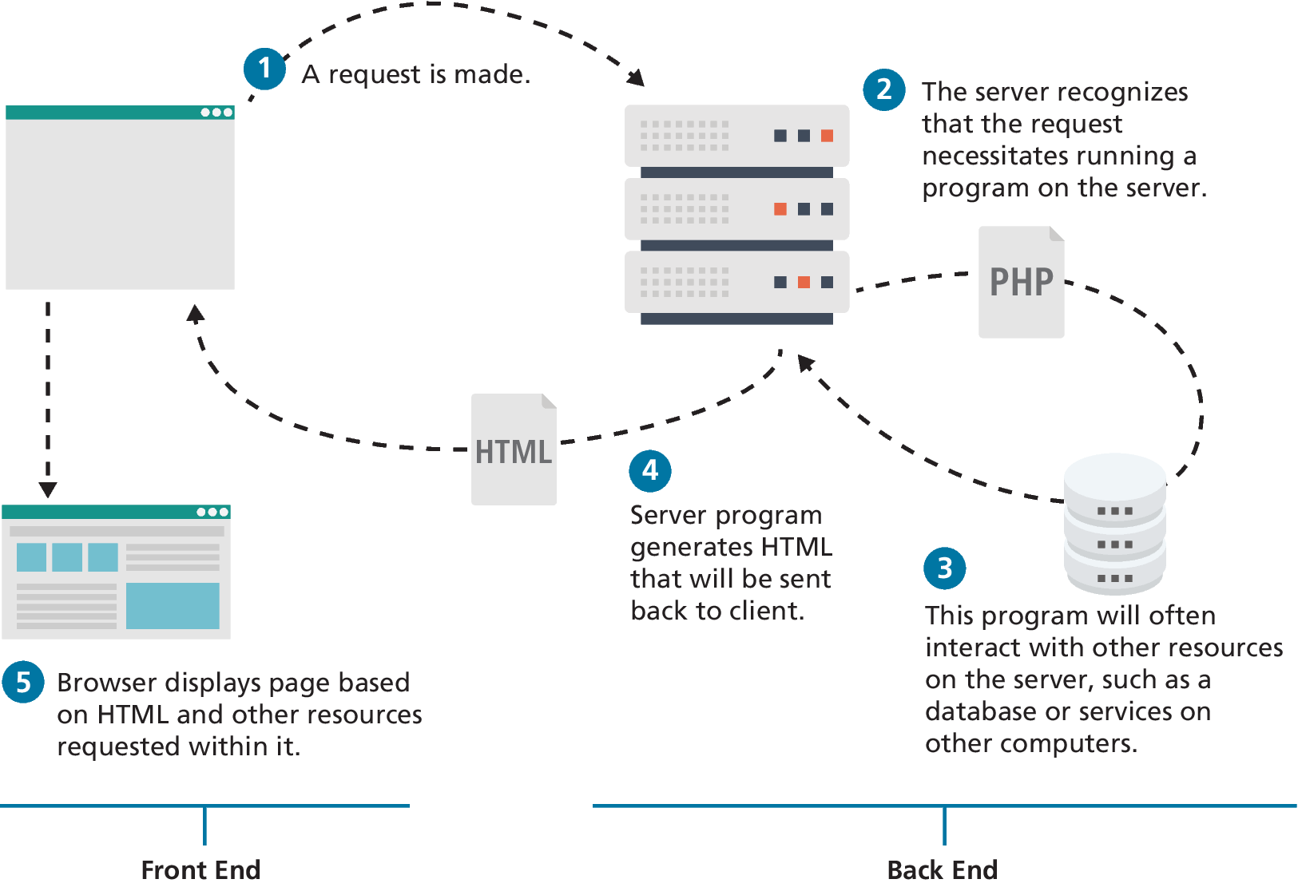
Front End versus Back End
Server-side technologies provide access to data sources, handled security, and allowed web sites to interact with external services such as payment systems.
Traditionally, most sites made use programs running on the server-side to programmatically generate the HTML sent to the browser.

Slide 4
Common Server-Side Technologies
ASP (Active Server Pages). This was Microsoft’s first server-side technology (also called ASP Classic).
ASP.NET. This replaced Microsoft’s older ASP technology.
JSP (Java Server Pages). JSP uses Java as its programming language and like ASP.NET it uses an explicit object-oriented approach and is used in large enterprise web systems and is integrated into the J2EE environment.
Node.js (or just Node). Uses JavaScript on the server side
Perl. excels in the manipulation of text.
PHP. Like ASP, PHP is a dynamically typed language that can be embedded directly within the HTML
Python. This terse, object-oriented programming language has many uses, including being used to create web applications.
Ruby on Rails. This is a web development framework that uses the Ruby programming language.

Slide 5
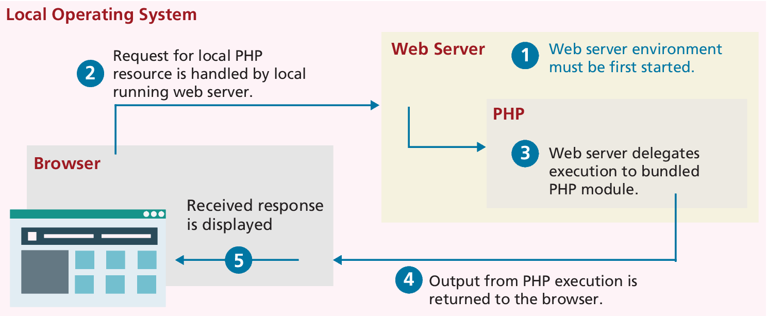
Running PHP locally
Installing Apache, PHP, and MySQL for Local Development

Slide 6
PHP Language Fundamentals
PHP is a a dynamically typed language (with optional static typing), and provides classes and functions in a way consistent with other object-oriented languages such as C++, C#, and Java.
The syntax for loops, conditionals, and assignment is identical to JavaScript, only differing when you get to functions, classes, and in how you define variables.

Slide 7
PHP Tags and comments
PHP code can be embedded directly within an HTML file. However, instead of having an .html extension, a PHP file will usually have the extension .php.
Code must be contained within an opening <?php tag and a matching closing ?> tag. Code within the <?php and the ?> tags is interpreted and executed, while any code outside the tags is echoed directly out to the client.
It is very common practice (especially when first learning PHP) for a PHP file to have HTML markup and PHP programming logic woven together.
PHP uses the same commenting mechanisms as JavaScript, namely multi-line block comments using /* */ or end-of-line comments using //

Slide 8
PHP Tag Example
<?php
$user = "Randy";
?>
<!DOCTYPE html>
<html>
<body>
<h1>Welcome <?php echo $user; ?></h1>
<p>
The server time is
<?php
echo "<strong>";
echo date("H:i:s");
echo "</strong>";
?>
</p></body></html>
<!DOCTYPE html>
<html>
<body>
<h1>Welcome Randy</h1>
<p>
The server time is <strong>02:59:09</strong>
</p>
</body>
</html>
LISTING 12.2 Output (HTML) from PHP script in Listing 12.1
LISTING 12.1 Php Tags

Slide 9
Variables and Data Types
Variables in PHP are dynamically typed. The PHP engine makes a best guess as to the intended type based on what it is being assigned.
Variables are also loosely typed in that a variable can be assigned different data types over time.
Boolean A logical true or false value
Integer Whole numbers
Float Decimal numbers
String Letters
Array A collection of data of any type (covered in the next chapter)
Object Instances of classes

Slide 10
PHP constants
A constant can be defined anywhere but is typically defined near the top of a PHP file via the define() function. The define() function generally takes two parameters: the name of the constant and its value. Notice that once it is defined, it can be referenced without using the $ symbol.
<?php
// uppercase for constants is a programming convention
define("DATABASE_LOCAL", "localhost");
define("DATABASE_NAME", "ArtStore");
define("DATABASE_USER", "Fred");
define("DATABASE_PASSWD", "F5^7%ad");
// ...
// notice that no $ prefaces constant names
$db = new mysqli( DATABASE_LOCAL, DATABASE_NAME, DATABASE_USER,
DATABASE_PASSWD);
?>
LISTING 12.3 PHP constants

Slide 11
Writing to Output
To output something that will be seen by the browser, you can use the echo() function.
echo("hello");
echo "hello"; //alternate version (no parenthesis)
Strings can be appended together using the concatenate operator, which is the period (.) symbol. Consider the following code:
$username = "Ricardo";
echo "Hello " . $username;
will output Hello Ricardo to the browser.

Slide 12
PHP quote and concatenation approaches
<?php
$firstName = "Pablo";
$lastName = "Picasso";
/*Example one:
These two lines are equivalent. Notice that you can reference PHP variables within a string literal defined with double quotes.
The resulting output for both lines is:
<em>Pablo Picasso</em>*/
echo "<em>" . $firstName . " ". $lastName. "</em>";
echo "<em> $firstName $lastName </em>";
/* Example two: These two lines are also equivalent. Notice that you can use either the single quote symbol or double quote symbol for string literals. */
echo "<h1>";
echo '<h1>’;
/* Example three: These two lines are also equivalent. In the second example, the escape character (the backslash) is used to embed a double quote within a string literal defined within double quotes. */
echo '<img src="23.jpg" >';
echo "<img src=\"23.jpg\" >";
?>
LISTING 12.4 PHP quote usage and concatenation approaches

Slide 13
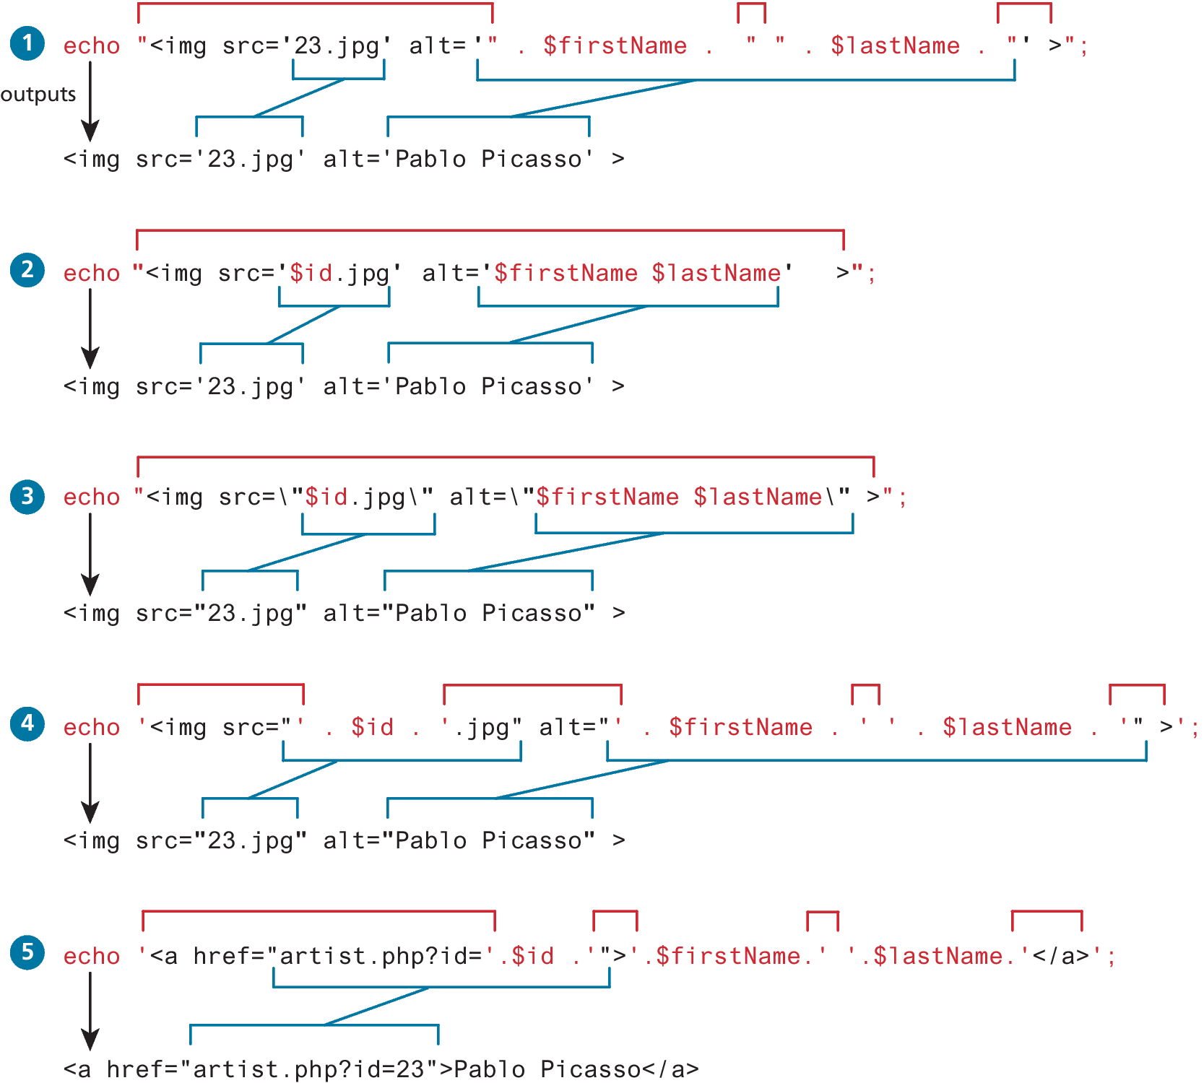
More concatenation examples

Slide 14
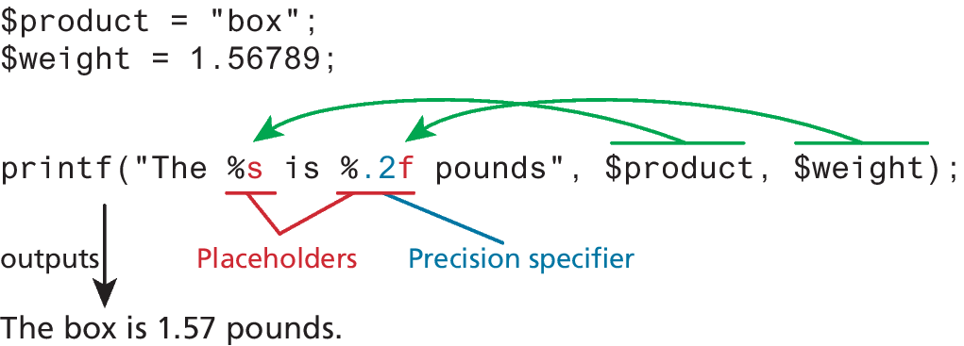
printf
The printf() function is derived from the C programming language is nearly ubiquitous in programming, appearing in many languages including Java, MATLAB, Perl, Ruby, and others.
The printf() function also allows a developer to apply special formatting, for instance, specific date/time formats or number of decimal places. It takes at least one parameter, which is a string, and that string optionally references parameters, which are then integrated into the first string by placeholder substitution.

Slide 15
Program Control
Just as with most other programming languages there are a number of conditional and iteration constructs in PHP.
if . . . else
switch . . . case
while and do . . . while
for

Slide 16
If…else
The syntax for conditionals in PHP is identical to that of JavaScript.
The condition to test is contained within () brackets with the body contained in {} blocks. Optional else if statements can follow, with an optional else ending the branch.
// if statement
if ( $hourOfDay > 6 && $hourOfDay < 12) {
$greeting = "Good Morning";
}
else if ($hourOfDay == 12) { // optional else if
$greeting = "Good Noon Time";
}
else { // optional else branch
$greeting = "Good Afternoon or Evening";
}
LISTING 12.7 Conditional snippet of code using if . . . else

Slide 17
PHP and HTML in the same script
<?php if ($userStatus == "loggedin") { ?>
<a href="account.php">Account</a>
<a href="logout.php">Logout</a>
<?php } else { ?>
<a href="login.php">Login</a>
<a href="register.php">Register</a>
<?php } ?>
<?php
// equivalent
if ($userStatus == "loggedin") {
echo '<a href="account.php">Account</a> ‘;
echo '<a href="logout.php">Logout</a>';
}
else {
echo '<a href="login.php">Login</a> ‘;
echo '<a href="register.php">Register</a>';
}
?>
LISTING 12.8 Combining PHP and HTML in the same script

Slide 18
switch . . . case
The switch statement is similar to a series of if ... else statements.
switch ($artType) {
case "PT":
$output = "Painting";
break;
case "SC":
$output = "Sculpture";
break;
default:
$output = "Other";
}
// equivalent
if ($artType == "PT")
$output = "Painting";
else if ($artType == "SC")
$output = "Sculpture";
else
$output = "Other";
LISTING 12.9 Conditional statement using switch and the equivalent if-else

Slide 19
while and do . . . while
In the while loop, the condition is tested at the beginning of the loop; in the do ... while loop the condition is tested at the end of each iteration of the loop.
$count = 0;
while ($count < 10) {
echo $count;
$count++;
}
$count = 0;
do {
echo $count;
// this one increments the count by 2 each time
$count = $count + 2;
} while ($count < 10);
LISTING 12.10 The while loops

Slide 20
For loops
The for loop in PHP has the same syntax as the for loop in JavaScript that we examined in Chapter 8. For loops contain the same loop initialization, condition, and postloop operations as in JavaScript.
// this one increments the value by 5 each time
for ($count=0; $count < 100; $count+=5) {
echo $count;
}
// this one increments the count by 1 each time
for ($count=0; $count < 10; $count++) {
echo $count;
}
LISTING 12.11 The for loops

Slide 21
Alternate Syntax for Control Structures
PHP has an alternative syntax for most of its control structures.
In this alternate syntax, the colon (:) replaces the opening curly bracket, while the closing brace is replaced with endif;, endwhile;, endfor;, endforeach;, or endswitch;.
<?php if ($userStatus == "loggedin") : ?>
<a href="account.php">Account</a>
<a href="logout.php">Logout</a>
<?php else : ?>
<a href="login.php">Login</a>
<a href="register.php">Register</a>
<?php endif; ?>
LISTING 12.12 Alternate syntax for control structures

Slide 22
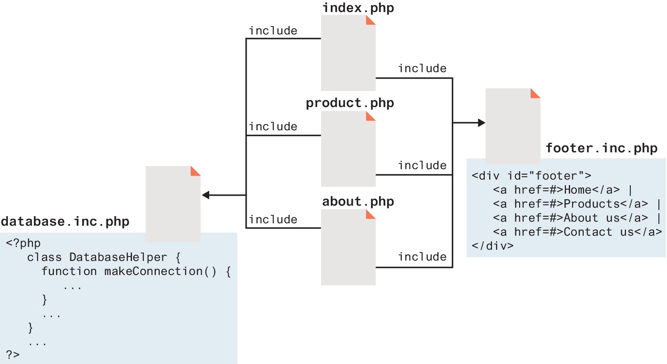
Include Files
PHP has the ability to include or insert content from one file into another. Include files provide a mechanism for reusing both markup and PHP code
include "somefile.php";
include_once "somefile.php";
require "somefile.php";
require_once "somefile.php";

Slide 23
Functions
Just like with JavaScript, a function in PHP contains a small bit of code that accomplishes one thing.
A user-defined function is one that you, the programmer, define.
A built-in function is one of the functions that come with the PHP environment (or with one of its extensions).

Slide 24
Function Syntax
Functions can return values to the caller, or not return a value.
They can be set up to take or not take parameters.
Function definition requires the use of the function keyword followed by the function’s name, round ( ) brackets for parameters, and then the body of the function inside curly { } brackets.
function getNiceTime(){
return date("H:i:s");
}

Slide 25

Return Type Declaration
P R O T I P
In PHP 7.0, the ability to explicitly define a return type for a function was added. A Return Type Declaration explicitly defines a function’s return type by adding a colon and the return type after the parameter list when defining a function.
function mustReturnString(string $name) : string {
return "hello ". $name;
}
LISTING 12.15 Return type declaration in PHP 7.0

Slide 26
Invoking a Function
To invoke or call a function you must use its name with the () brackets. Since getNiceTime() returns a string, you can assign that return value to a variable, o echo that return value directly, as shown in the following example:
$output = getNiceTime();
echo getNiceTime();
If the function doesn’t return a value, you can just call the function:
outputFooterMenu();

Slide 27
Parameters
Parameters are the mechanism by which values are passed into functions. To illustrate, let us write another version of getNiceTime() that takes an integer as a parameter to control whether to show seconds. You will call the parameter showSeconds
function getNiceTime($showSeconds) {
if ($showSeconds==true)
return date("H:i:s");
else
return date("H:i");
}
LISTING 12.16 A function with a parameter

Slide 28
Parameter Default Values
In PHP you can set parameter default values for any parameter in a function. However, once you start having default values, all subsequent parameters must also have defaults.
function getNiceTime($showSeconds=true) {
if ($showSeconds==true)
return date("H:i:s");
else
return date("H:i");
}
LISTING 12.17 A function with a parameter default

Slide 29
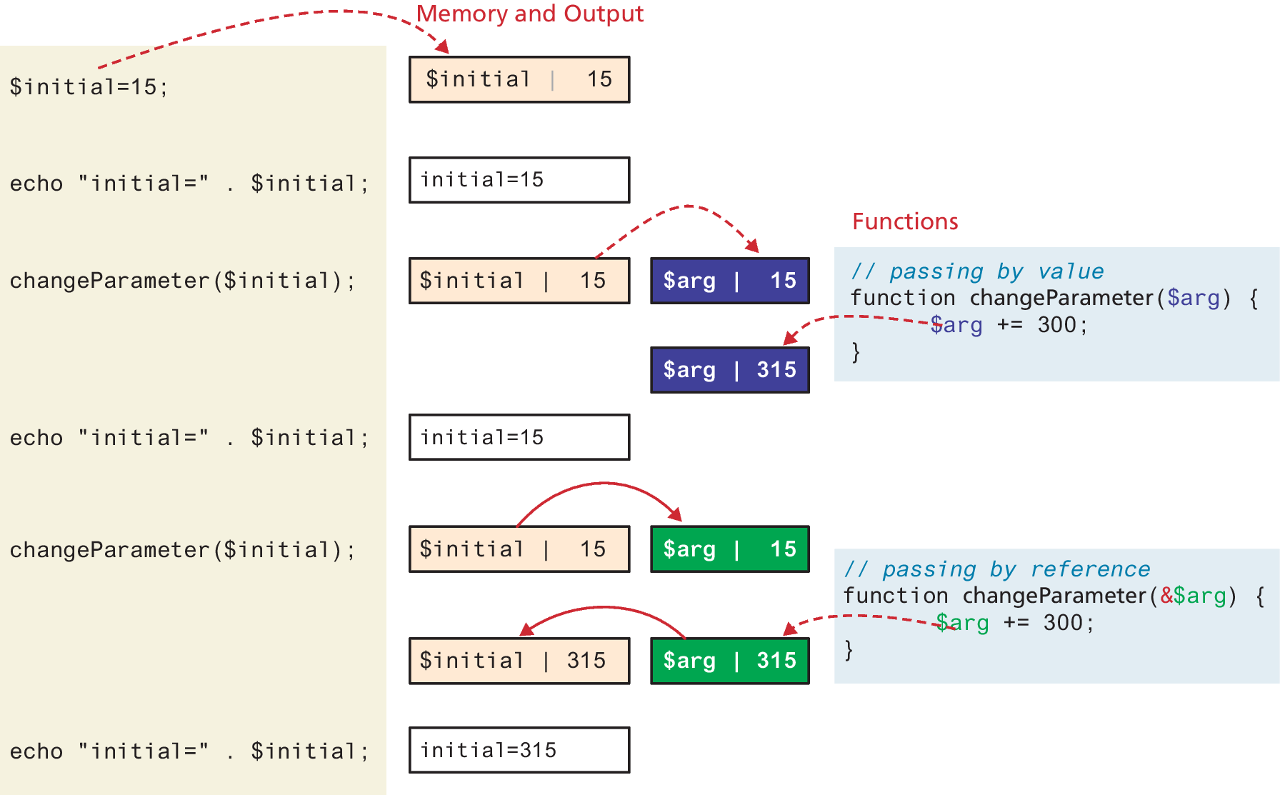
Passing Parameters by Reference
By default, arguments passed to functions are passed by value in PHP.
PHP also allows arguments to functions to be passed by reference
The mechanism in PHP is to add an ampersand (&) symbol next to the parameter name in the function declaration.

Slide 30
Parameter-type declaration
It is now possible to require that a particular parameter be of a particular type. To add a type to a parameter, add a type specification (int, float, string, bool, callable, or any class name you have defined) before the parameter name.
function getNiceTime(bool $showSeconds=true) {
if ($showSeconds==true)
return date("H:i:s");
else
return date("H:i");
}
LISTING 12.20 Using a parameter-type declaration

Slide 31
Variable Scope within Functions
All variables defined within a function have function scope, meaning that they are only accessible. within the function. It might be surprising though to learn that, unlike JavaScript, any variables created outside of the function in the main script are unavailable within a function.
PHP does allow variables with global scope to be accessed within a function using the global keyword, though generally speaking, its usage is discouraged.

Slide 32
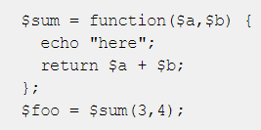

Anonymous & => Functions
Version 7.4 of PHP added two JavaScript-inspired additions to functions. This includes anonymous functions as well as arrow syntax. However, arrow functions can only contain a single line. These functions do have access to variables defined outside their function, but not to superglobal arrays.

Slide 33
Arrays
Unlike most other programming languages (including JavaScript), in PHP an array is actually an ordered map, which associates each value in the array with a key.
This allows you to use arrays in PHP in a manner similar to other languages’ arrays, but you can also use them like other languages’ collection classes.
Array keys restricted to integers and strings
Array values, unlike keys, are not restricted to integers and strings. They can be any object, type, or primitive supported in PHP.

Slide 34
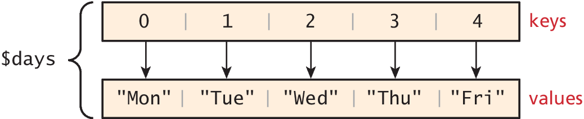
Defining an Array
The following declares an empty array named days:
$days = array();
To define the contents of an array as strings for the days of the week, you declare it using either of two following syntaxes:
$days = array("Mon","Tue","Wed","Thu","Fri");
$days = ["Mon","Tue","Wed","Thu","Fri"]; // alternate syntax

Slide 35
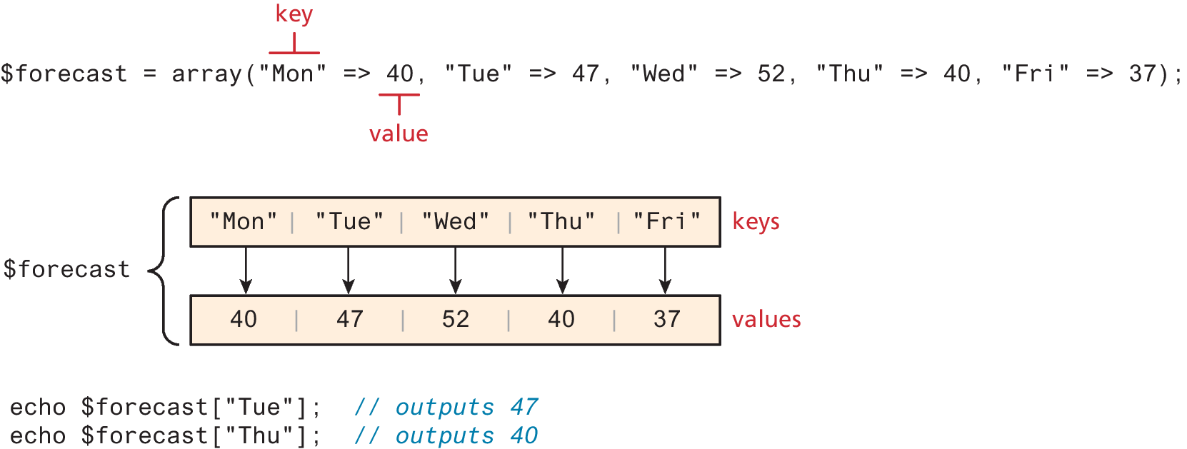
Accessing an Array
Explicit control of the keys and values opens the door to keys that do not start at 0, are not sequential, and that are not even integers (but rather strings).

Slide 36
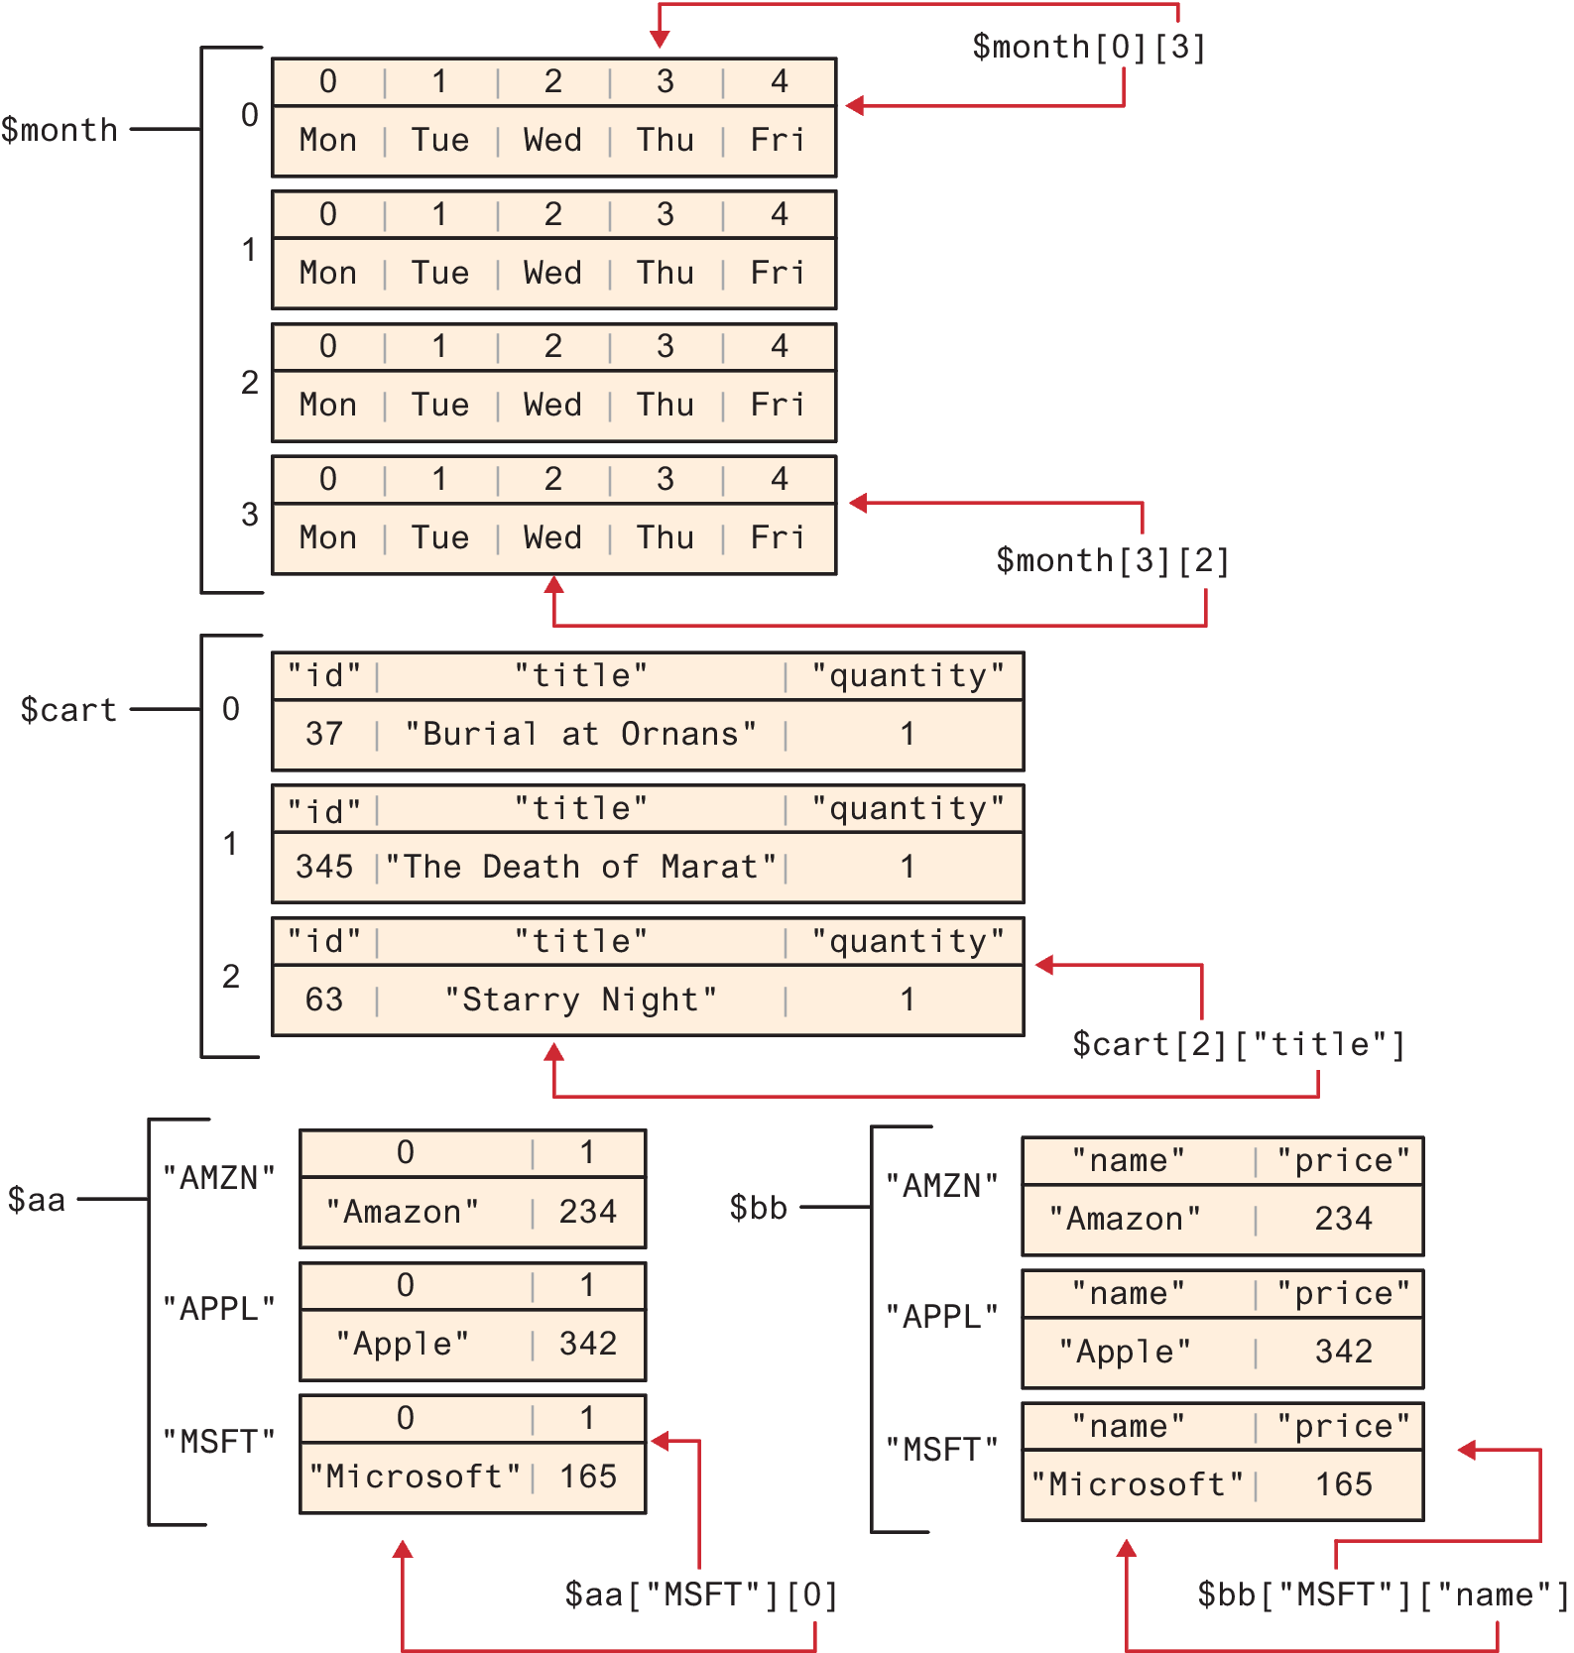
Multidimensional Arrays
$month = array(
array("Mon","Tue","Wed","Thu","Fri"),
array("Mon","Tue","Wed","Thu","Fri"),
array("Mon","Tue","Wed","Thu","Fri"),
array("Mon","Tue","Wed","Thu","Fri")
);
LISTING 12.22 Multidimensional arrays

Slide 37
Multidimensional Arrays (ii)
$cart = [];
$cart[] = array("id" => 37,
"title" => "Burial at Ornans",
"quantity" => 1);
$cart[] = array("id" => 345,
"title" => "The Death of Marat",
"quantity" => 1);
$cart[] = array("id" => 63,
"title" => "Starry Night",
"quantity" => 1);
LISTING 12.22 Multidimensional arrays

Slide 38
Multidimensional Arrays (iii)
$stocks = [
["AMZN", "Amazon"],
["APPL", "Apple"],
["MSFT", "Microsoft"]
];
$aa = [
"AMZN" => ["Amazon", 234],
"APPL" => ["Apple", 342],
"MSFT" => ["Microsoft", 165]
];
$bb = [
"AMZN" => ["name" =>"Amazon", "price" => 234],
"APPL" => ["name" => "Apple", "price" => 342],
"MSFT" => ["name" => "Microsoft", "price" => 165]
];
LISTING 12.22 Multidimensional arrays

Slide 39
Iterating through an Array
// while loop
$i=0;
while ($i < count($days)) {
echo $days[$i] . "<br>";
$i++;
}
// for loop
for ($i=0; $i<count($days); $i++) {
echo $days[$i] . "<br>";
}
// iterating through the values
foreach ($forecast as $value) {
echo $value . "<br>";
}
// iterating through the values AND the keys
foreach ($forecast as $key => $value){
echo "day[" . $key . "]=" . $value;
}
LISTING 12.23 Iterating through an array using while, do while, and for loops
LISTING 12.24 Iterating through an associative array using a foreach loop

Slide 40
Adding and Deleting Elements
In PHP, arrays are dynamic, that is, they can grow or shrink in size.
An element can be added to an array simply by using a key/index that hasn’t been used, as shown below:
$days[5] = "Sat";
A new element can be added to the end of any array using empty square brackets after the array name, as follows:
$days[] = "Sun";
You can also explicitly delete array elements using the unset() function

Slide 41
Checking if a Value Exists
To check if a value exists for a key, you can therefore use the isset() function, which returns true if a value has been set, and false otherwise
$oddKeys = array(1 => "hello", 3 => "world", 5 => "!");
if (isset($oddKeys[0])) {
// The code below will never be reached since //$oddKeys[0] is not set!
echo "there is something set for key 0";
}
if (isset($oddKeys[1])) {
// This code will run since a key/value pair was defined //for key 1
echo "there is something set for key 1, namely ". $oddKeys[1];
}
LISTING 12.26 Illustrating nonsequential keys and usage of isset( )

Slide 42

Classes and Objects
Classes outline properties and methods like a blueprint. Each variable created from a class is called an object or instance, and each object maintains its own set of variables, an behaves (largely) independently from the class once created.

Slide 43
Defining and instantiating Classes
The PHP syntax for defining a class uses the class keyword followed by the class name and { } braces.
class Artist {
public $firstName;
public $lastName;
public $birthDate;
public $birthCity;
public $deathDate;
}
LISTING 12.27 A simple Artist class

Slide 44
Properties
instantiate objects using the new keyword
$picasso = new Artist();
$dali = new Artist();
You can access and modify the properties of each object separately using its variable name and an arrow (->),
$picasso = new Artist();
$dali = new Artist();
$picasso->firstName = "Pablo";
$picasso->lastName = "Picasso";
$picasso->birthCity = "Malaga";
$picasso->birthDate = "October 25 1881";
$picasso->deathDate = "April 8 1973";
LISTING 12.28 Instantiating and using objects

Slide 45
Constructors
You should therefore define constructors, which lets you specify parameters during instantiation to initialize the properties within a class right away.
In PHP, constructors are defined as functions with the name __construct().
(Note: there are two underscores_ before the word construct.)
class Artist {
// variables from previous listing still go here
...
function __construct($firstName, $lastName,
$city, $birth,$death=null) {
$this->firstName = $firstName;
$this->lastName = $lastName;
$this->birthCity = $city;
$this->birthDate = $birth;
$this->deathDate = $death;
}
}
LISTING 12.29 A constructor added to the class definition

Slide 46
Methods
Methods define the tasks each instance of a class can perform and are useful since they associate behavior with objects.
Call the method as follows:
$picasso = new Artist(. . .)
echo $picasso->outputAsTable();
class Artist {
public function outputAsTable() {
$table = "<table>";
$table .= "<tr><th colspan='2'>";
$table .= $this->firstName . " " . $this->lastName;
$table .= "</th></tr>";
$table .= "<tr><td>Birth:</td>";
$table .= "<td>" . $this->birthDate;
$table .= "(" . $this->birthCity . ")</td></tr>";
$table .= "<tr><td>Death:</td>";
$table .= "<td>" . $this->deathDate . "</td></tr>";
$table .= "</table>";
return $table;
}
}
LISTING 12.30 Method definition

Slide 47
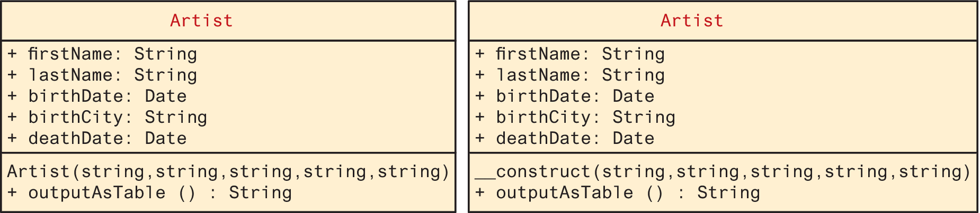
Sample ways to diagram a class using UML

Slide 48
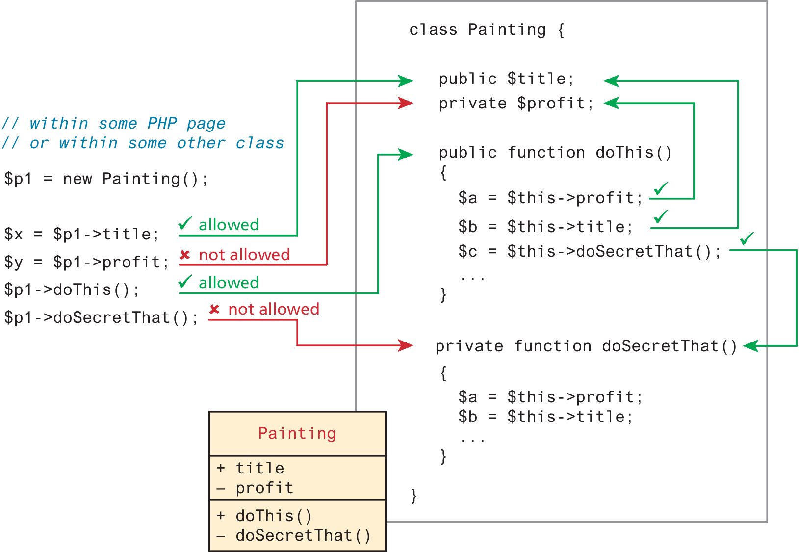
Visibility
The visibility of a property or method determines the accessibility of a class member
A property or method and can be set to public, private, or protected

Slide 49
Static Members
Static member is a property or method that all instances of a class share.
To illustrate how a static member is shared between instances of a class, we will add the static property artistCount to our Artist class, and use it to keep a count of how many Artist objects are currently instantiated
class Artist {
public static $artistCount = 0;
public $firstName;
public $lastName;
public $birthDate;
public $birthCity;
public $deathDate;
function __construct($firstName, $lastName, $city,$birth, $death=null) {
$this->firstName = $firstName;
$this->lastName = $lastName;
$this->birthCity = $city;
$this->birthDate = $birth;
$this->deathDate = $death;
self::$artistCount++;
}
}
LISTING 12.31 Class definition modified with static members

Slide 50
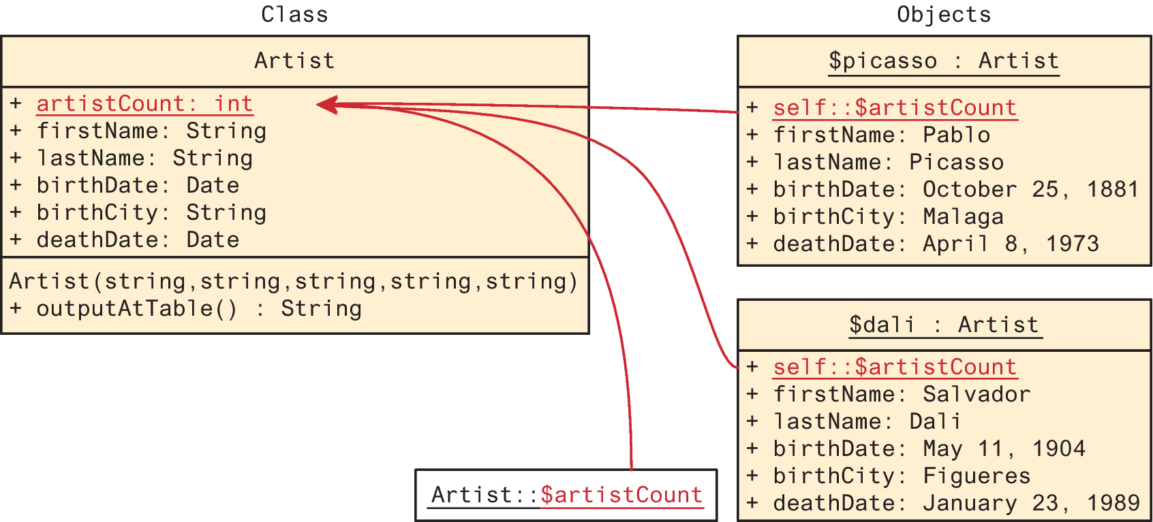
A static property in UML

Slide 51
Inheritance
Inheritance enables you to create new PHP classes that reuse, extend, and modify the behavior that is defined in another PHP class.
A class that is inheriting from another class is said to be a subclass or a derived class.
The class that is being inherited from is typically called a superclass or a base class.
Just as in Java, a PHP class is defined as a subclass by using the extends keyword.
class Painting extends Art { . . . }

Slide 52
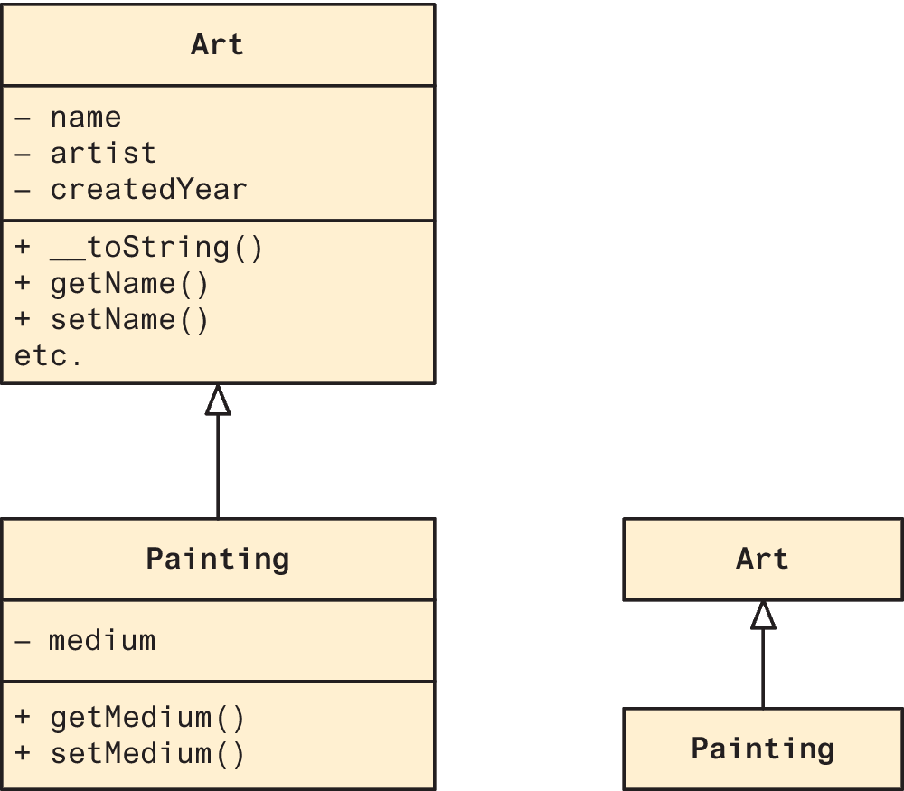
UML showing inheritance
Both references below work because it is as if the base class public members are defined within the subclass.
$p = new Painting();
echo $p->getName(); // defined in base class
echo $p->getMedium(); // defined in subclass

Slide 53
$_GET and $_POST Superglobal Arrays
PHP uses special predefined associative arrays called superglobal arrays that allow the programmer to easily access HTTP headers, query string parameters, and other commonly needed information
$GLOBALS Array for storing data that needs superglobal scope
$_COOKIES Array of cookie data passed to page via HTTP request
$_ENV Array of server environment data
$_FILES Array of file items uploaded to the server
$_GET Array of query string data passed to the server via the URL
$_POST Array of query string data passed to the server via the HTTP header
$_REQUEST Array containing the contents of $_GET, $_POST, and $_COOKIES
$_SESSION Array that contains session data
$_SERVER Array containing information about the request and the server

Slide 54
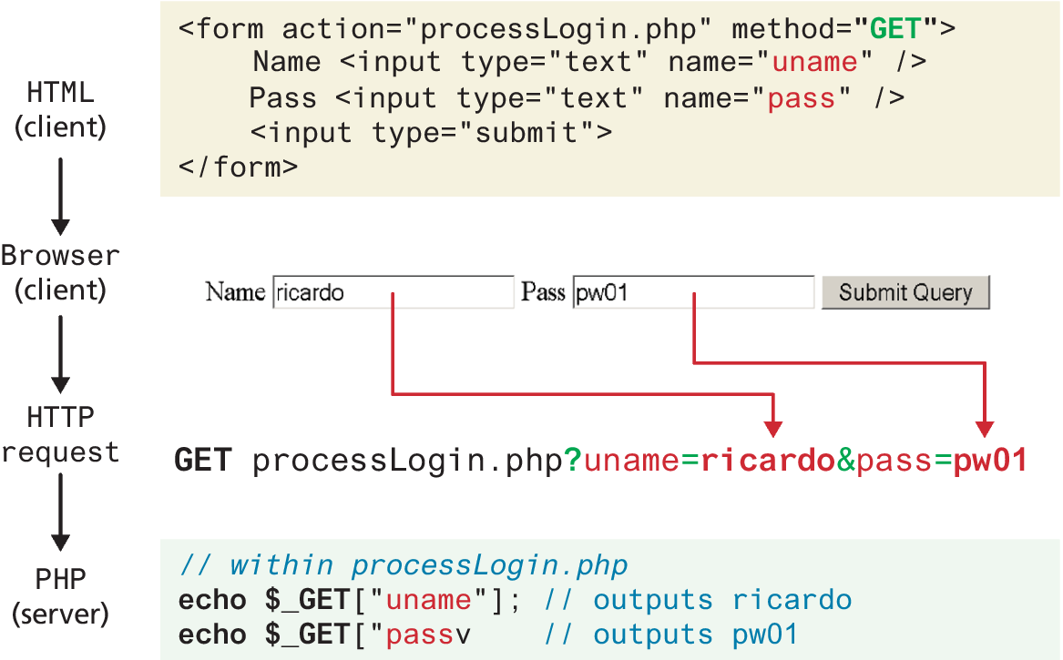
Illustration of flow into $_GET array

Slide 55
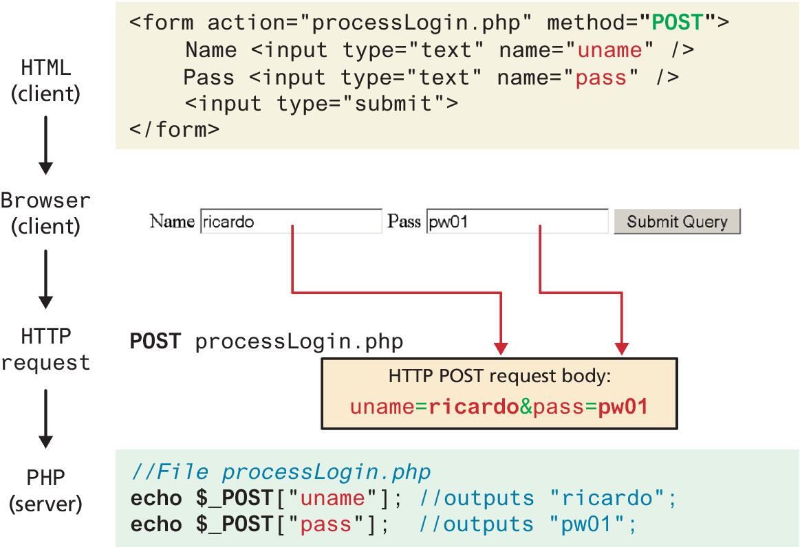
Illustration of flow into $_POST array

Slide 56
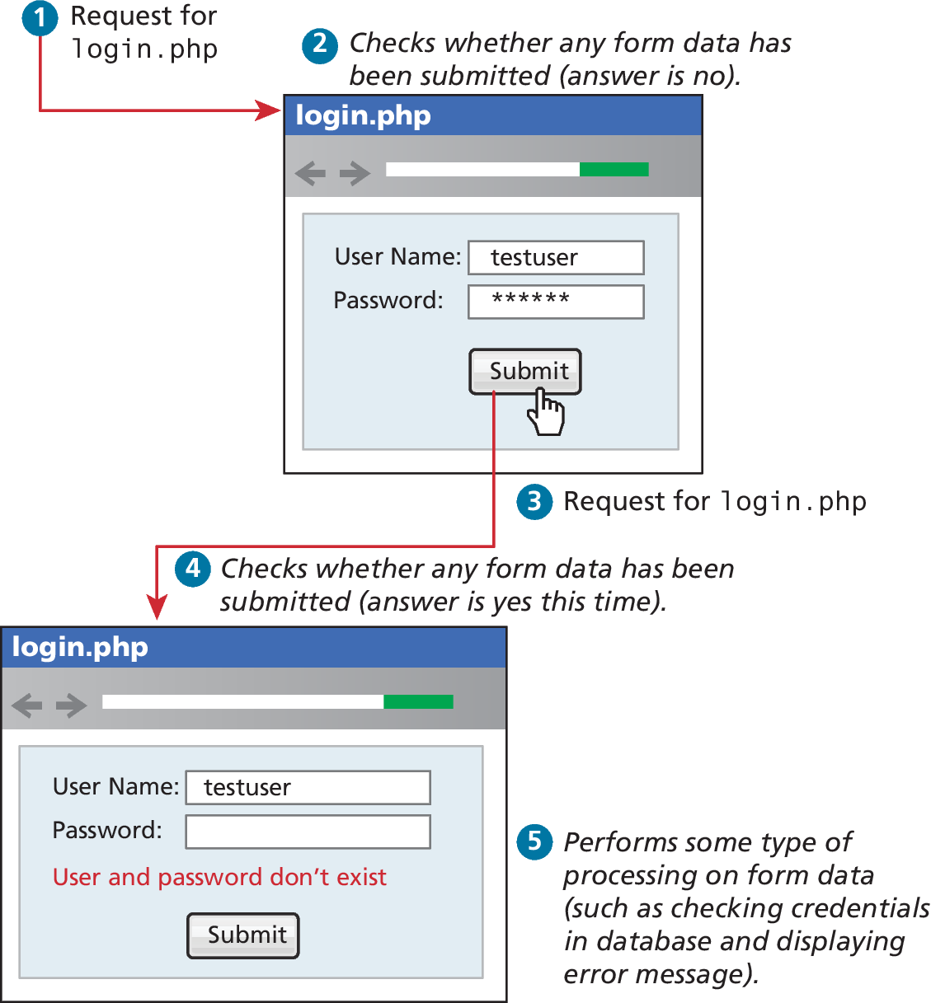
Determining If Any Data Sent
<?php
if ($_SERVER["REQUEST_METHOD"] == "POST") {
if ( isset($_POST["uname"]) && isset($_POST["pass"]) ) {
// handle the posted data.
echo "handling user login now ...";
echo "... here we could redirect or authenticate ";
echo " and hide login form or something else";
}
}

Slide 57
Accessing Form Array Data
Sometimes in HTML forms, you might have multiple values associated with a single name. Unfortunately, if the user selects more than one day and submits the form, the $_GET['day'] value in the superglobal array will only contain the last value from the list that was selected.
To overcome this limitation, you must change the HTML in the form. In particular, you will have to change the name attribute for each checkbox from day to day[]
echo "You submitted " . count($_GET['day']) . "values";
foreach ($_GET['day'] as $d) {
echo $d . " <br>";
}
LISTING 12.34 PHP code to display an array of checkbox variables

Slide 58
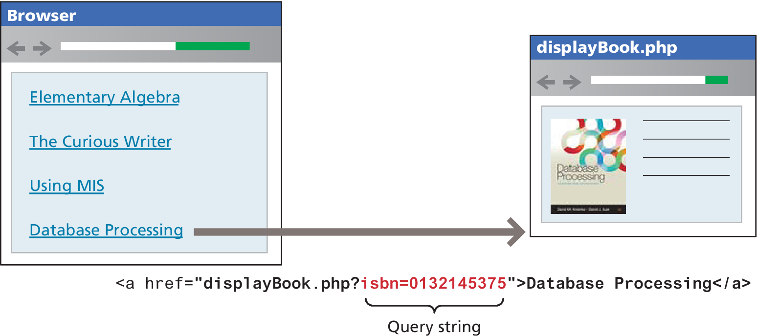
Using Query Strings in Hyperlinks

Slide 59
Sanitizing Query Strings
One of the most important things to remember about web development is that you should actively distrust all user input.
The process of checking user input for incorrect or missing information is sometimes referred to as the process of sanitizing user inputs.
// This uses a database API ... we will learn about it in Chapter 14
$pid = mysqli_real_escape_string($link, $_GET['id']);
if ( is_int($pid) ) {
// Continue processing as normal
}
else {
// Error detected. Possibly a malicious user
}
LISTING 12.35 Simple sanitization of query string values

Slide 60
Working with the HTTP Header
So far in this chapter, PHP has been used to modify the response sent back to the browser. In PHP, echo statements adds content after the HTTP response header.
It is possible in PHP to modify the response header using the header() function, but why would we?
Redirecting Using Location Header
Setting the Content-Type Header

Slide 61
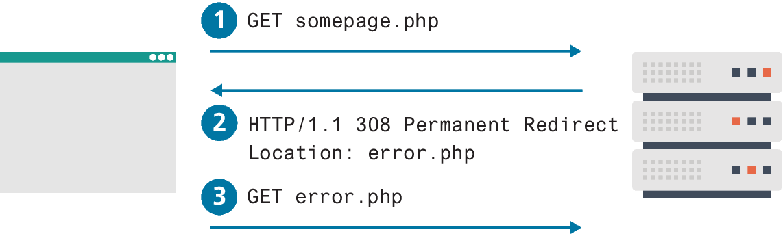
Redirecting Using Location Header
One of the most common uses of this function in PHP is to redirect. For instance, a PHP page might redirect to an error page when an expected querystring parameter is missing
<?php
if (! isset($_GET['id']) {
header("Location: error.php");
}
...?>

Slide 62
Setting the Content-Type Header
The Content-Type HTTP header is used to tell the browser what type of content (using a MIME type) it is receiving in the response.
Normally, the PHP environment automatically sets this header to text/html. However, you might want to change this header value. 2 common examples are:
Returning JSON Data
Outputting Custom Images

Slide 63
Key Terms
array
array keys
array values
associative arrays
branch
built-in function
classes
Common Gateway
Interface (CGI)
concatenation
constant
constructors
data types
dynamically typed
function
function scope
global scope
inheritance
instance
instantiate
local repository
loosely typed
magic methods
methods
naming conventions
one-way hash
parameter default values
parameters
passed by reference
passed by value
properties
remote repository
return-type declarations
sanitizing user inputs
server-side includes (SSI)
subclass
superclass
superglobal arrays
user-defined function
visibility

Slide 64

Copyright
This work is protected by United States copyright laws and is provided solely for the use of instructors in teaching their courses and assessing student learning. Dissemination or sale of any part of this work (including on the World Wide Web) will destroy the integrity of the work and is not permitted. The work and materials from it should never be made available to students except by instructors using the accompanying text in their classes. All recipients of this work are expected to abide by these restrictions and to honor the intended pedagogical purposes and the needs of other instructors who rely on these materials.

